Slide 1
Teaching Spoken Tamil: The Problem of 'Authenticity'
Harold Schiffman
University of Pennsylvania
Texas Workshop on Teaching Tamil
March 12, 2010

Slide 2
Need for ‘authentic’ language
Recently in language pedagogy, common to focus on need for ‘authentic’ language.
Need to avoid artificial or stilted kinds of forms, e.g. ‘La plume de ma tante est dans le jardin’ (The pen of my aunt is in the garden)
My favorite from a Telugu class: ‘These are my five green umbrellas’

Slide 3
Difficulty of defining ‘authenticity’
What is ‘authentic’ Spoken Tamil?
What is ‘inauthentic’ Spoken Tamil?
Term first used for Tamil by Britto (1986) in his study of diglossia.
Claimed that ‘authentic’ communication was done only in ST, and that Literary Tamil was never used for ‘authentic’ communication
LT only used in oratory, formal ‘platform’ or ceremonial speech

Slide 4
Spoken Tamil used to express:
Innermost feelings: emotion
Spontaneous communication
Humor (jokes, cartoons, etc.)

Slide 5
Problems with this:
Spoken Tamil has many dialects
Some ST dialects are stigmatized:
Usage may be ‘vulgar’ and perceived as ‘coarse’
Usage may be seen as ‘substandard’ or associated with (a) social group(s) that are unfavorably viewed by Tamil society.

Slide 6
‘Authenticity’ needs to be narrowed down:
We need to teach a kind of Spoken Tamil that sounds natural and unstilted
Needs to be acceptable to educated speakers
Otherwise, educated speakers will ‘correct’ our students for use of ‘non-standard’ or unacceptable forms
Students will then lose confidence in their ability to speak
Our efforts to teach them authentic Tamil will have been in vain

Slide 7
How extreme is Tamil Diglossia?
avarai eppaDiyoo anuppuvittuviDaveeNDum
he-ACC somehow send+CAUS+past+COMPL+Modal
Rules that apply:
v-deletion (including vowels following v__ )
Palatalization of dentals (tt) after -i → cc
Cluster reduction: NC → N
Monophthongization: [ai] → [e]
Short-vowel deletion:
Nasalization of final -v+nas → [û]
Assimilation of n → m / ___p
→ avare epDiyoo ampciDaNû
'Somehow or other, (we) have to get rid of him.'

Slide 8
How natural is this example?
When I first encountered this utterance in ST, I could not figure it out
But with the v-deletion, palatalization, and short-vowel deletion, radical changes occur
None of this is ‘radical’ or ‘vulgar’ or unusual
Getting students to see these differences as natural and ‘authentic’ is a difficult task

Slide 9
Automatic rules to convert LT to Spoken Tamil?
The previous examples makes use of some ‘automatic’ rules to get from LT to ST
This does not mean that the use of these rules will always get the user to an authentic spoken form
Spoken Tamil is its own system, and in the drive to get to ‘authentic’ speech, factors that are ‘speaker-centered’ will take precedence
In particular we find lexical differences, and different use of the aspectual auxiliaries such as viDu and koL

Slide 10
Problems of authenticity in other languages:
In studies of languages like creoles, researchers have proposed a continuum:
Most acceptable form is ‘standard’ or ‘acrolectal’
Beneath that we get a ‘continuum’ that descends to the ‘basilectal’.
All of these forms are ‘authentic’
But would we want to teach students these forms?
If we do, educated speakers will ‘correct’ them
They will lose confidence in our teaching

Slide 11
Limits of authenticity:
The Acrolectal forms:
More Basilectal forms:
He's a man who likes his beer.
He's a man that likes his beer.
He's a man 'at likes his beer. (Acceptable to me, but very colloquial)
He's a man 'at likes his beer.
He's a man as likes his beer.
He's a man what likes his beer.
He's a man he likes his beer.
He's a man likes his beer.

Slide 12
Acceptable speech:
Within the boundaries of ‘authenticity’ we need to declare a zone of ‘acceptability’
Acceptable forms are those that:
Do not arouse commentary or attention from educated speakers
Are deemed ‘appropriate’ by educated speakers
Do not evoke associations with unacceptable groups or stigmatized behaviors
Are widely understood within the speech community
Are midway between ‘stilted/artificial’ and ‘peculiar’ or even vulgar

Slide 13
authenticauthenticauthentic
Within the boundaries of ‘authenticity’ we need to declare a narrower zone of ‘acceptability’

Slide 14
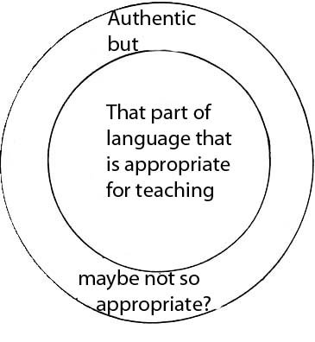

Slide 15
So what is acceptable Spoken Tamil and what is not?
Our dictionary ST examples have been criticized by some people as being stilted and/or unnatural
Problem: we don’t have a large database of ST examples we can draw from.
Movies and radio/TV sitcoms are one possibility but we need to create a database for this
We also need them to do some surveys to get people to make judgments about what sounds acceptable and authentic, and what does not

Slide 16
The Matched-Guise Test:
Since the 1960’s in Canada and elsewhere, the matched-guise test has been used in over 140 studies
Bilingual (or bidialectal people) are identified who sound like monolinguals in each language.
Are recorded saying the “same thing” in two languages or dialects
Sound files are then ‘scrambled’ so the five speakers speaking twice sound like 10 different speakers

Slide 17
Questions asked:
Subjects (themselves bilingual/bidialectal) are asked to listen to the recordings and make judgements about the person speaking, and not the language samples.
Asked about speakers educational level:
What kind of jobs might they have?
How tall are they?
How much money do they earn?
How friendly are they?

Slide 18
Judgments:
In a bilingual or bidialectal setting, one group is always ranked higher than the other
Even the two lects spoken by each bidialectal or bilingual person are judged differently
In Canada, English speakers are more highly ranked, by both Anglophone and Francophone subjects
The Francophone ‘guise’ only comes out ahead on the issue of friendliness.

Slide 19
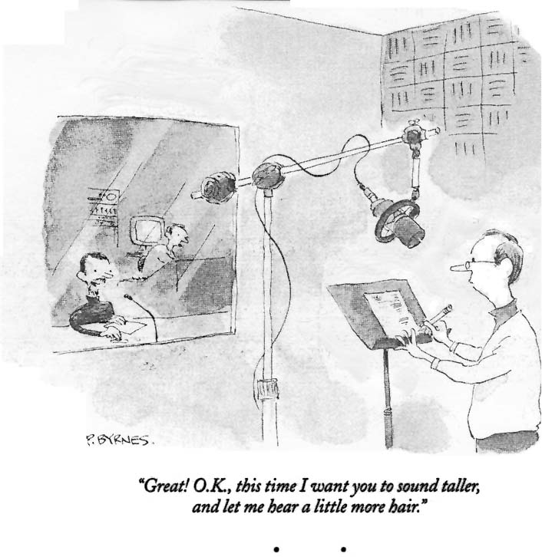
Sound taller, with more hair (?)

Slide 20
We need to do this for Spoken Tamil
I have always wanted to do this, but foreigners on research visas in India are not allowed to do ‘surveys’
Recently, a researcher in Singapore has done some matched-guise surveys among Tamil teachers and other educated speakers
Goal was to introduce ST as a medium of instruction along with LT in Singapore classrooms
Results have been published, but more work needs to be done

Slide 21
Another thing that needs to be done:
Start a project to record the all the dialogues of Tamil social films, radio and TV sitcoms, and any other broadcast usage of Spoken Tamil
Focus on the dialect spoken by the ‘central’ character (hero and heroine) since this usually the most ‘acceptable’
Ancillary characters are often mocked, lampooned, and ridiculed through use of ‘stigmatized’ speech. Their speech may be ‘authentic’ but not of use for pedagogy--need to be studied separately

Slide 22
Why study the stigmatized speech?
Even if we don’t use it as a model to teach, we need to familiarize students with it so they can understand it
Examples from English:
Whyncha say so? (for ‘Why didn’t you say so?)
Didja bring the papers witcha? (Did you bring the papers with you?)
Auono. (For ‘I don’t know?)
Forms like these, while ‘authentic’ are usually not taught, so learners have to figure them out for themselves.

Slide 23
Other things we found in our data:
In addition to some stilted kinds of examples, we found some forms we have questions about:
Many examples of past forms like ‘vanduTTadu’ occurring as just ‘vanduTTu’ without the –adu. At first I ‘corrected’ them; then I left them in.
Many examples of forms like keTTupooccu given with a short /a/ instead of /oo/: keTTupaccu, settupanaan, etc. These I corrected
But these forms and their acceptability need to be tested and evaluated—do a matched guise with them (and other stigmatized forms) contrasted with more ‘standard’ forms

Slide 24
Conclusion:
I believe there is a ‘standard’ form of Spoken Tamil and that we can determine what it is
It is very similar to what is used by the ‘central’ characters in films and other media.
Various researchers have discussed this issue and have c0me to the same conclusion
But we need more data on what is acceptable for pedagogy, and what is not.

Slide 25
Example:
When I speak Tamil on the telephone, nobody asks me who I am or contests my usage in any way. (E.g. ordering a ticket from a travel agency)
Then when I go in person to collect my ticket (or whatever), they don’t know who I am; and the ticket is made out to Mr. Shivaram!
My Tamil is not perfect, but it is acceptable.
I am taken (on the phone) probably for an Indian speaker of another language, and no questions are asked
And nobody ‘corrects’ my Tamil (to my face)

Slide 26
So we don’t need to teach our students to have ‘perfect’ pronunciation—we won’t be able to do that, anyway
We just need to find the acceptable norms and teach those, but we need more research on this in order to be able to assert and insist on the best forms to teach
Otherwise we will get arguments from mother-tongue speakers, who usually believe that their speech is the closest to ‘standard’.

